Slide 1
Classification of Documents Using KNN And Graph
2021-CS-06 Mahnoor Fatima
2021-CS-43 Mahnoor Ejaz

Slide 2
Agenda
04
Classification
01
Introduction
02
Data Collection
03
Graph Construction
05
Accuracy and Confusion metrix
06
Challanges

Slide 3
Introduction
Objective
Methodology used
Topics (Fashion, sports, disease/symptoms)
Why this classification is important

Slide 4



Data Collection
Scrapping through Python script
Beautiful-Soup
Sellenium

Slide 5
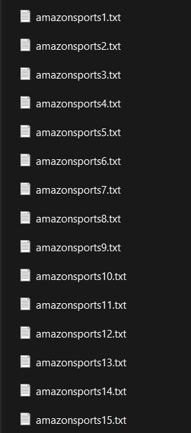
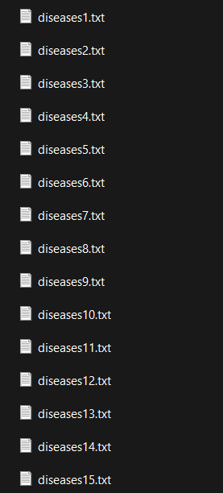
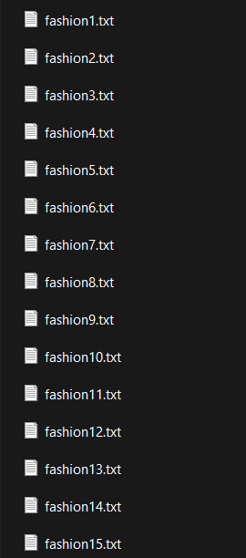
Data Collection (Out put files)
Approx. 500 words
in each file (raw)
15 documents each
topic

Slide 6
Data Collection (Preprocessing)
Approx. 300 words after preprocessing
Techniques Applied:
Stop words removal: involves eliminating common words (e.g., "the", "is", "and") from a text corpus, as they typically do not carry significant meaning for analysis.
Tokenization: is the process of breaking a text into smaller units, such as words or phrases, called tokens.
Stemming: is the process of reducing words to their root or base form, typically by removing suffixes and prefixes, to normalize variations of words.

Slide 7
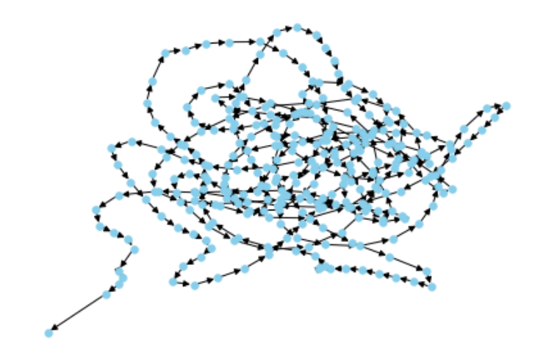
Graph Construction
Methodology: matplot
Directed graph

Slide 8
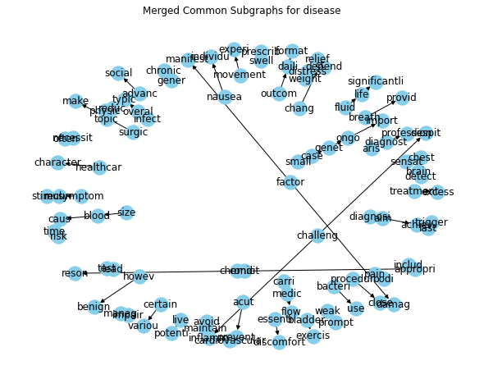
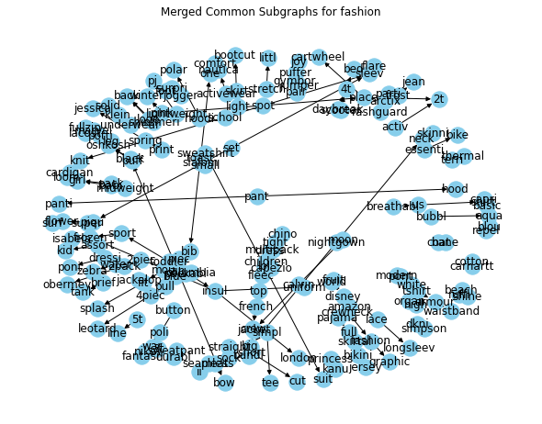
Graph Construction
Methodology: matplot
Subgraphs graph

Slide 9
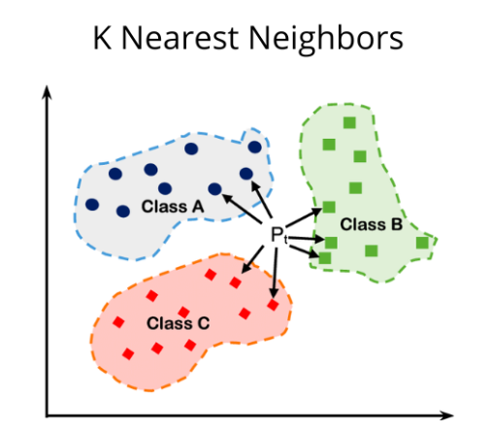
Classification using KNN
K-Nearest Neighbors (KNN) is a non-parametric algorithm used for classification and regression, relying on similarity measures between data points to make predictions based on nearby neighbors.

Slide 10
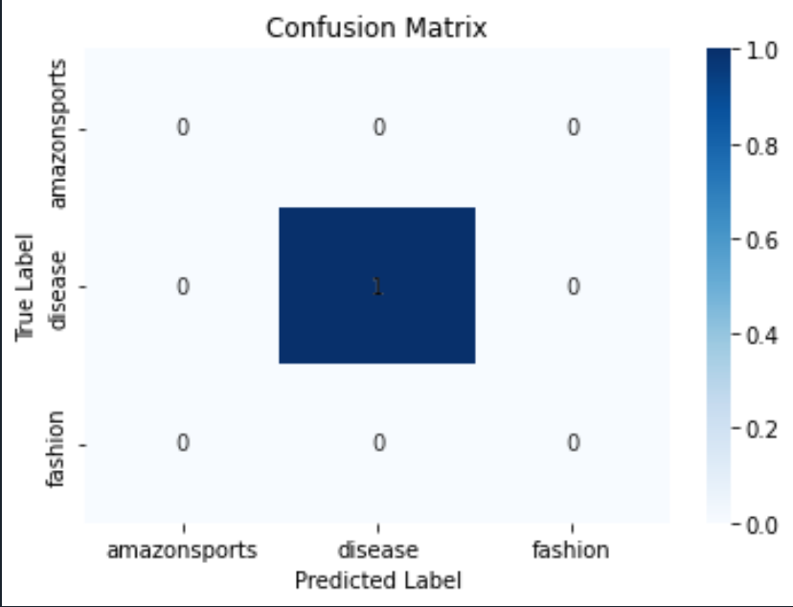
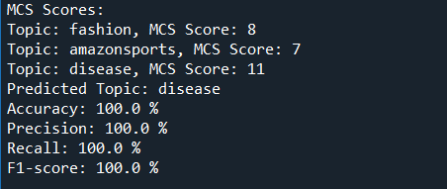
Accuracy and Confusion Matrix
For a single test file

Slide 11
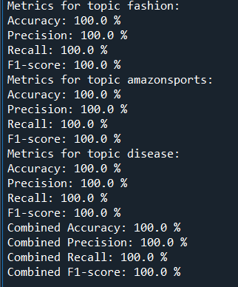
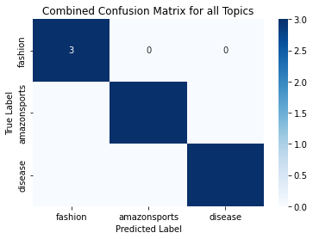
Accuracy and Confusion Matrix
For a all test file

Slide 12
Messy HTML
Interpretability
Graph plotting
Challanges
Optimization
Accuracy attainability
confusing code that's hard to understand
Understanding the model's predictions and interpreting the results can be challenging
careful consideration of the graph structure and node-edge relationships
optimal performance is essential but can be time-consuming
Saturno está compuesto por helio

Slide 13
THANK YOU

